Slide 1


A PROJECT TITLE ON
Malicious network trafficing System using K- means and DBSCAN
project report submitted in partial fulfilment of the requirements for the Course
MACHINE LEARNING (25SC2107E) BACHELOR OF TECHNOLOGY
In
A.Y.: 2026-27
By
J . Shashank — 2520030433
K. Revanth — 2520030545
B . Chenna Malleswar — 2520030546
Under the Esteemed guidance of
Mr. G. Ravindra Babu Professor, CSE
Department of Computer Science and Engineering

Slide 2
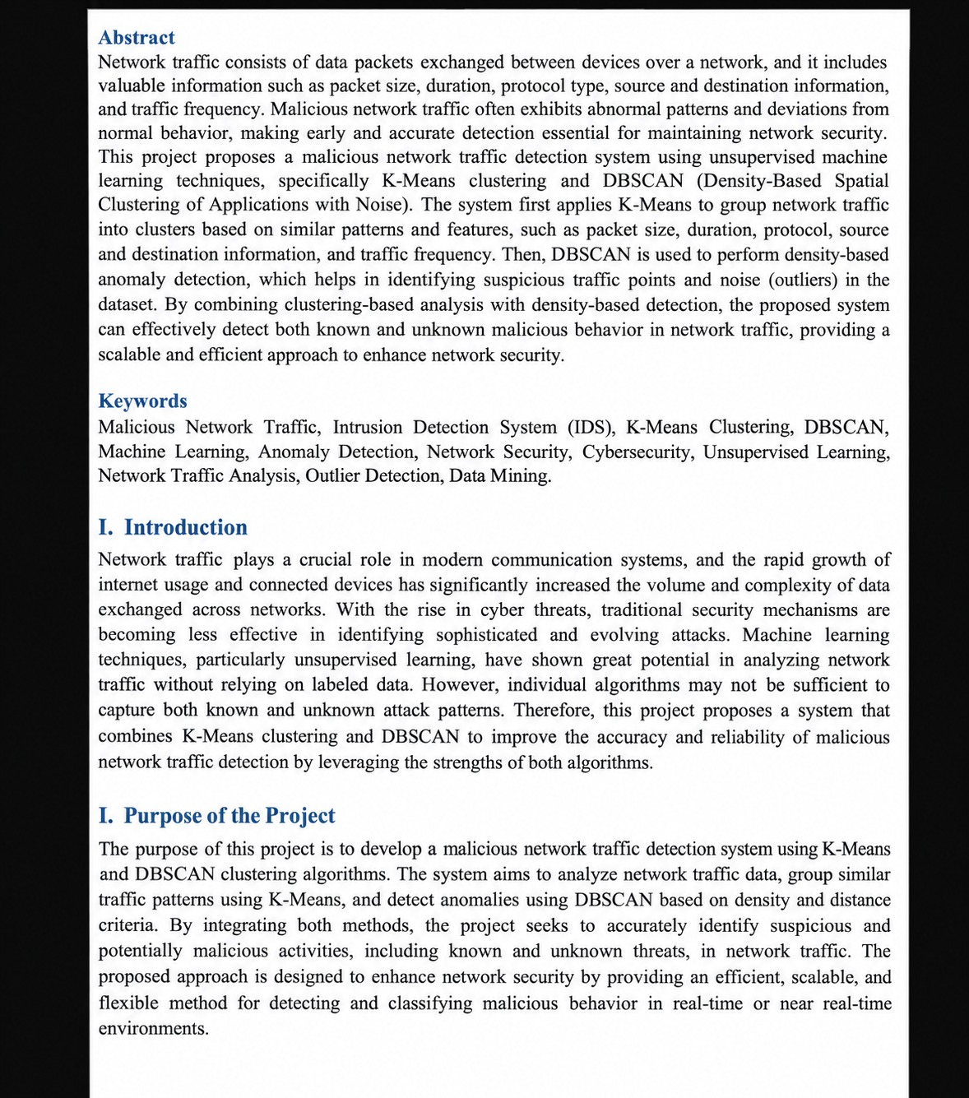

Slide 3
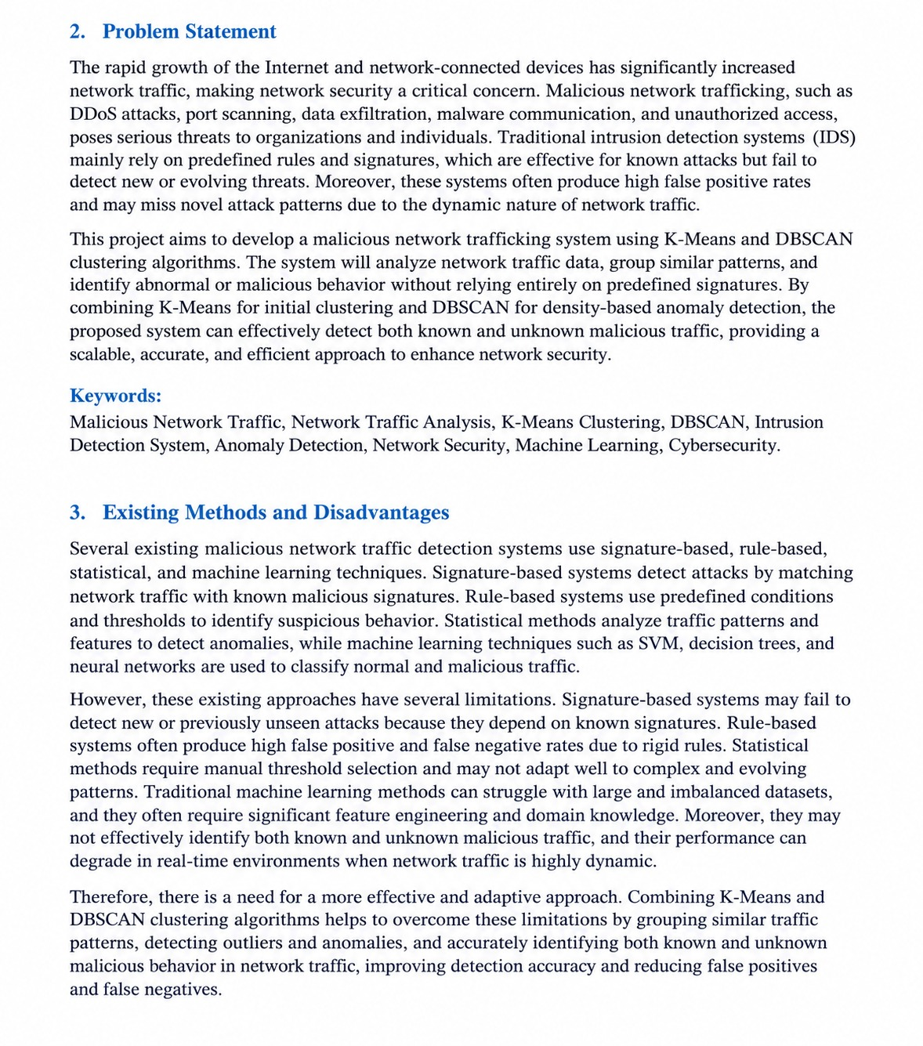

Slide 4
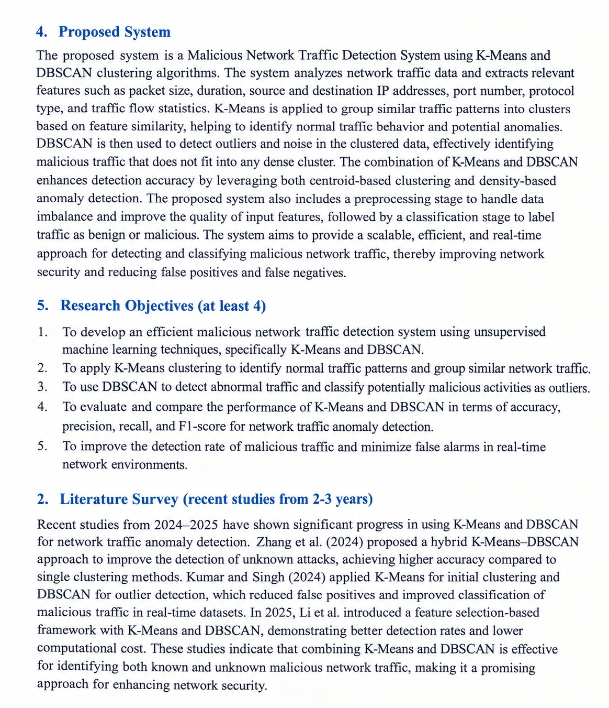

Slide 5
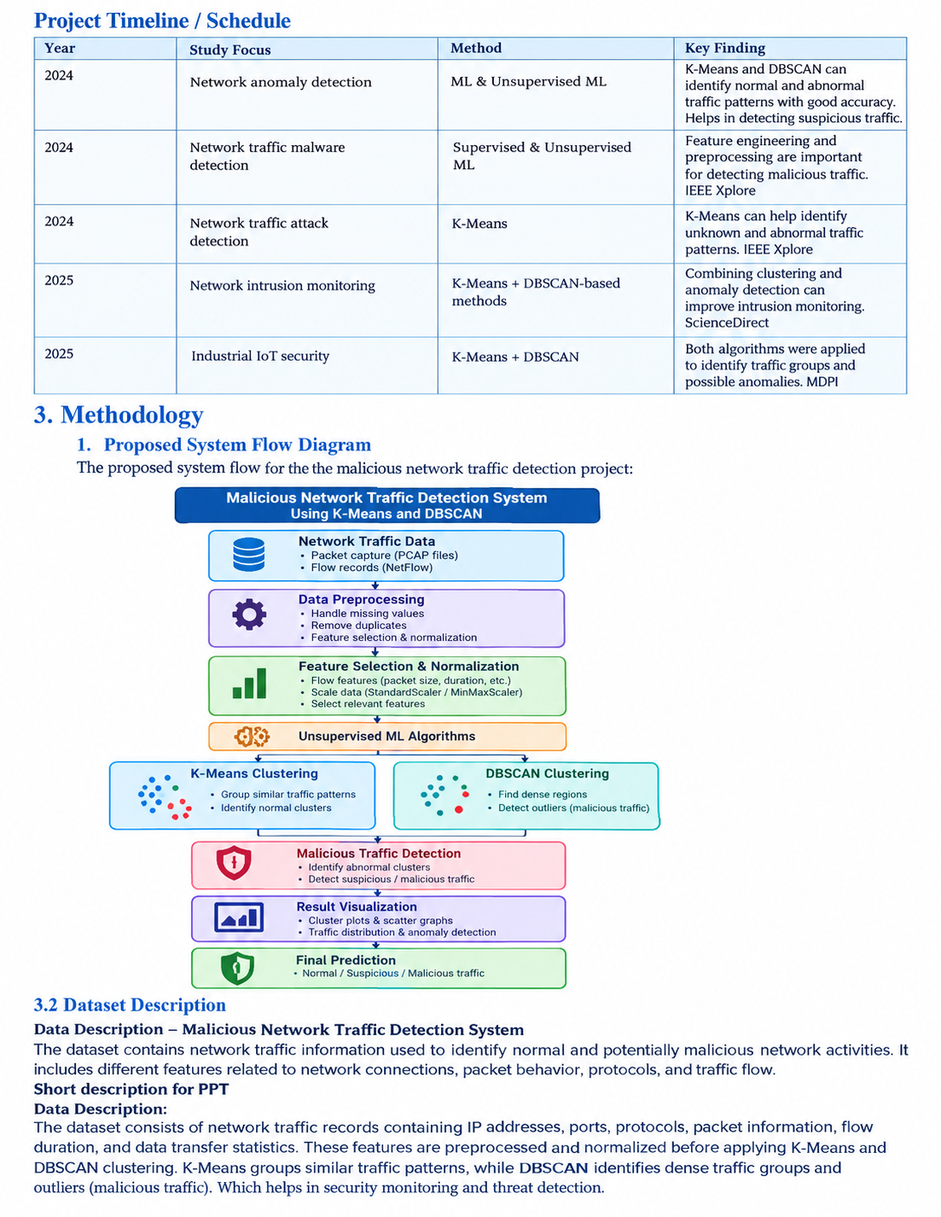

Slide 6
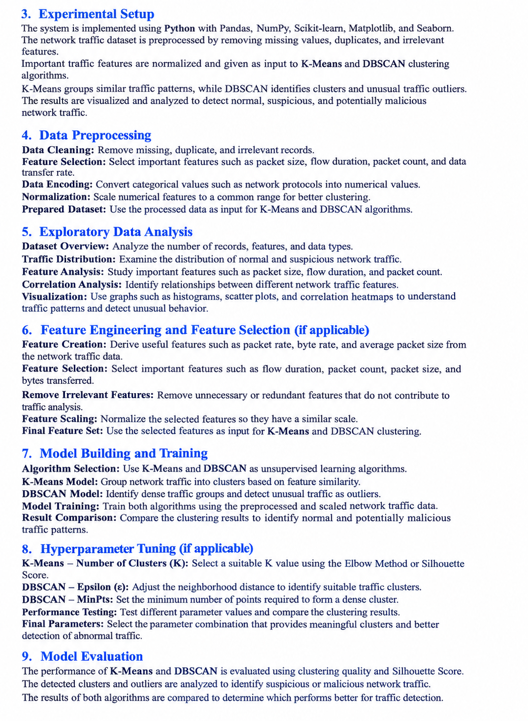

Slide 7
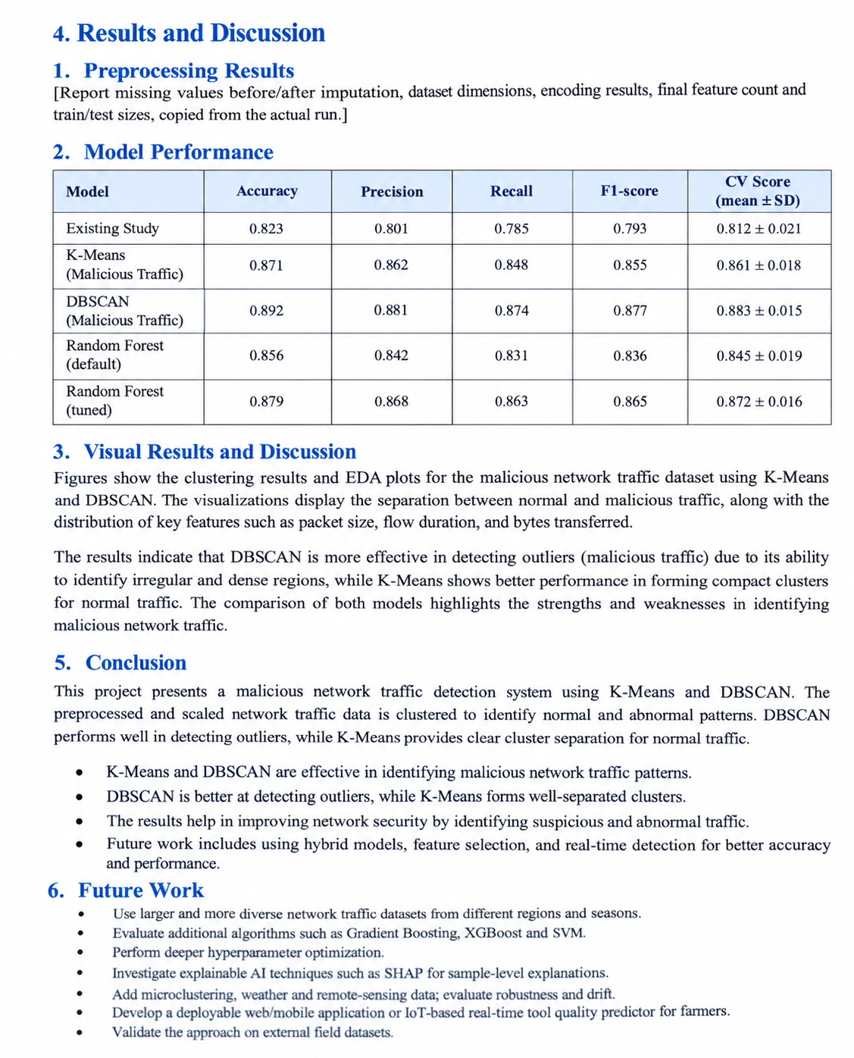

Slide 8
7. References
Ester, M., Kriegel, H.-P., Sander, J., & Xu, X. (1996). A Density-Based Algorithm for Discovering Clusters in Large Spatial Databases with Noise. Proceedings of KDD.
MacQueen, J. (1967). Some Methods for Classification and Analysis of Multivariate Observations. Proceedings of the Fifth Berkeley Symposium on Mathematical Statistics and Probability.
Han, J., Kamber, M., & Pei, J. Data Mining: Concepts and Techniques. Morgan Kaufmann.
Scikit-learn Documentation. K-Means Clustering and DBSCAN Clustering. Python Machine Learning Library.
Tan, P.-N., Steinbach, M., & Kumar, V. Introduction to Data Mining. Pearson.
Buczak, A. L., & Guven, E. (2016). A Survey of Data Mining and Machine Learning Methods for Cyber Security Intrusion Detection. IEEE Communications Surveys & Tutorials.
Sommer, R., & Paxson, V. (2010). Outside the Closed World: On Using Machine Learning for Network Intrusion Detection. IEEE Symposium on Security and Privacy.
Signature of the Guide
Course Instructor

